Slide 1
Transportation Management System
Project Proposal
Team:
Md Maruf Hossain (223014110)
Sadia Islam Prity (223014099)
Yasin Khandakar (223014141)
Sumaiya Akter (223014151)

Slide 2
Motivation
The transportation and logistics industry, a backbone of global commerce, faces inefficiencies like delayed shipments, poor tracking, and ineffective communication among stakeholders.
As businesses grow, manual fleet and shipment management becomes complex, leading to increased costs and reduced customer satisfaction.
The Transportation Management System (TMS) leverages cutting-edge technology to:
Centralize and automate logistics processes.
Enhance real-time tracking and optimize routing.
Improve communication and streamline workflows.
This system aims to reduce delays, operational costs, and environmental impact while delivering superior customer and stakeholder experiences.

Slide 3
Benefits / Contribution
Improved Visibility: Real-time tracking using integrated map APIs.
Enhanced Efficiency: Automated route optimization for faster delivery.
User-Friendly Interface: Easy-to-use dashboard for managing shipments.
Centralized Data Management: Seamless management of shipments, drivers, and vehicles.
Scalable Solution: Easily expandable for future fleet size and services.

Slide 4
Database
Users: UserID (PK), Name, Role(Admin, Driver, Client), Contact Info
Vehicles: VehicleID (PK), VehicleType, Capacity, Status (Available, In Transit, Maintenance)
Drivers: DriverID (PK), Name, LicenseNumber, Phone, AssignedVehicle (Foreign Key: VehicleID)
Shipments: ShipmentID (PK), UserID (FK), DriverID (FK), VehicleID (FK), Source, Destination, Status (Pending, In Transit, Delivered)
Locations: LocationID (PK), ShipmentID (FK), Latitude, Longitude, Timestamp
Schedule: ScheduleID (PK), VehicleID (FK), DriverID (FK), StartTime, EndTime, RouteID (FK)
Routes: RouteID (PK), StartLocation, EndLocation, EstimatedDuration, Distance
Booking: BookingID (PK), UserID (FK), ShipmentID (FK), BookingDate, Status (Confirmed, Canceled, Completed)

Slide 5
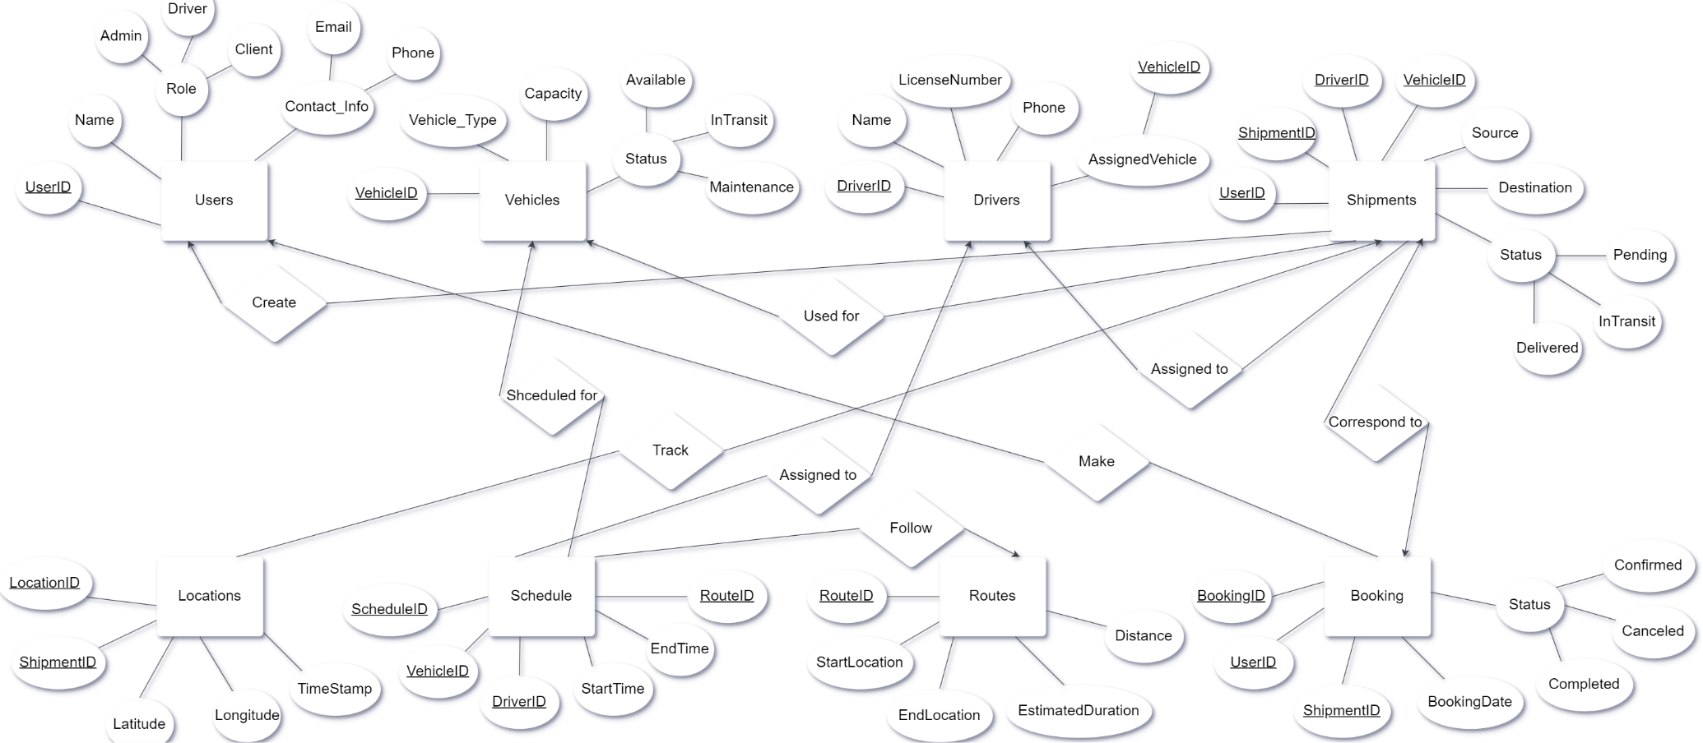
ER Diagram

Slide 6
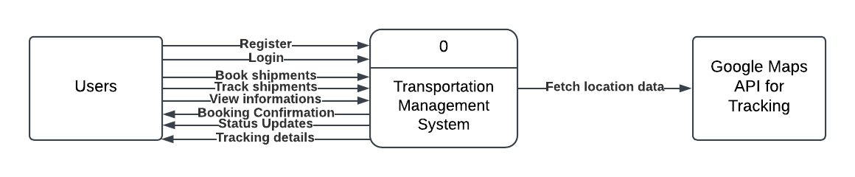
Data Flow Diagram
DFD level 0

Slide 7
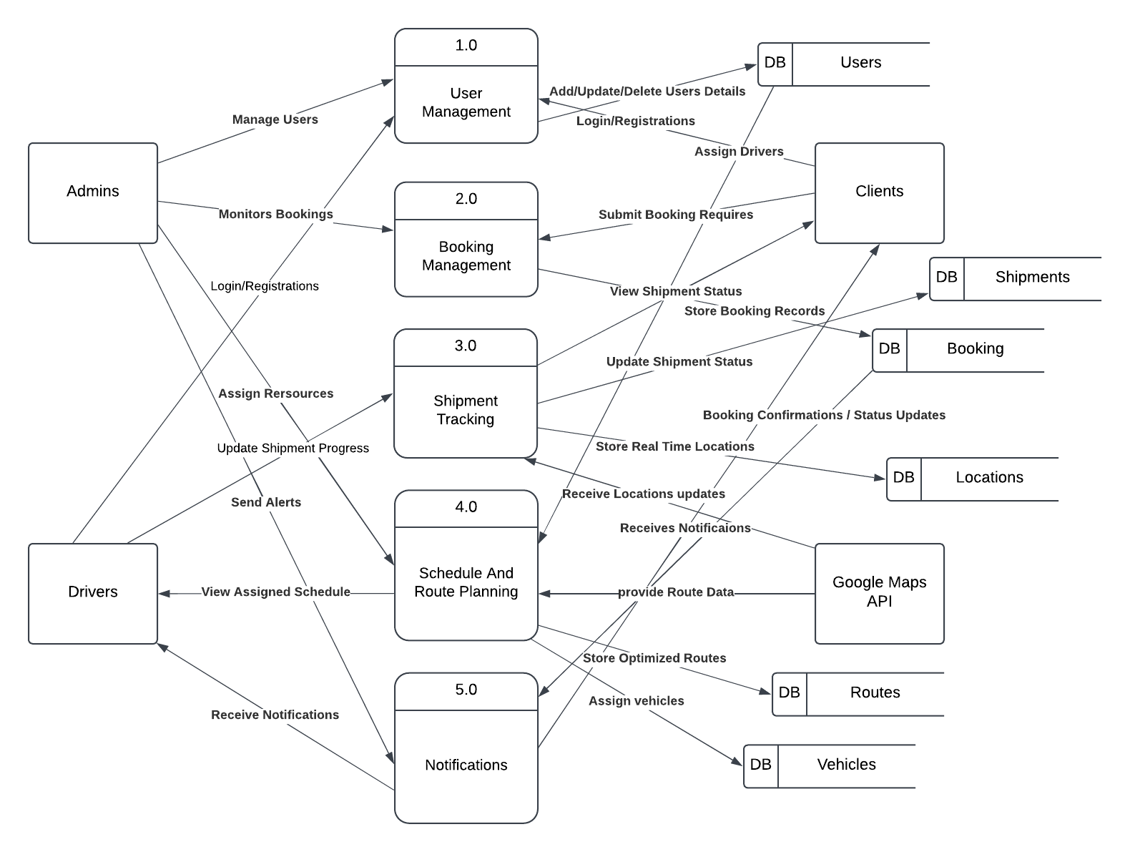
Data Flow Diagram
DFD level 1

Slide 8
Language and Environment
Frontend: HTML, CSS, JavaScript (React)
Backend: Node.js with Express
Database: MySQL (XAMPP)
Development Environment: Visual Studio Code
API Integration: Google Maps API for tracking, mock API for testing

Slide 9
Conclusion
The TMS aims to improve transportation processes through enhanced tracking, efficiency, and user experience.
With a scalable design and integrated technologies, the system is ready to handle future expansions.

Slide 10
Thank You

